Slide 1


Who are we ?

Slide 2

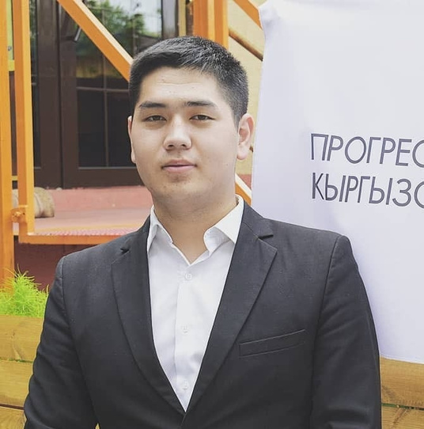
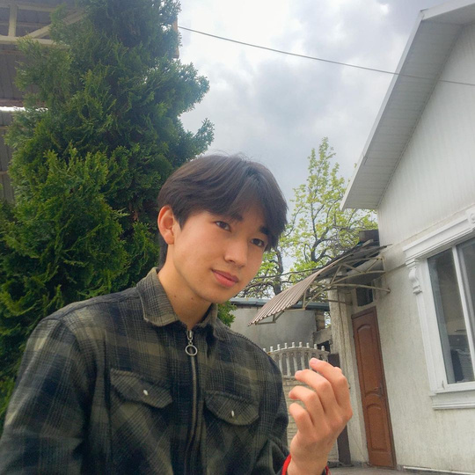
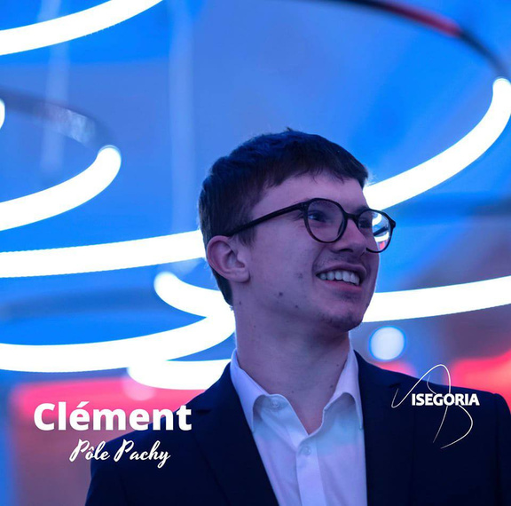
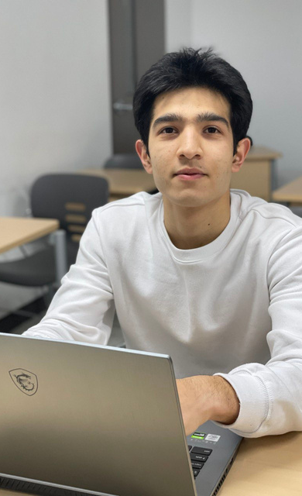
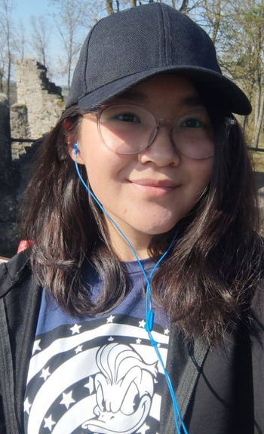

Group G
ASKAR ERNIST
12204546
ZHAMIN BALTABAEV
12204566
CLEMENT STOCCO
12224928
FERUZ UBAYDULAEV
12204578
RYSKELDI ZHYLDYZ
12224979

Slide 3

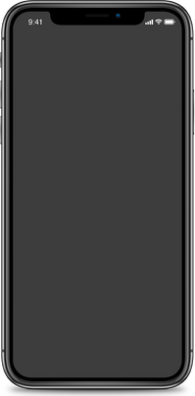



HAPPY LEARNER
Our platform is the key for getting qualitative knowledge for everyone. We would like to provide affordable courses to enlarge the number of bright people in this world.
We are aiming to educate and open new positions for people who would like to teach and enjoy sharing with a knowledge.

Slide 4
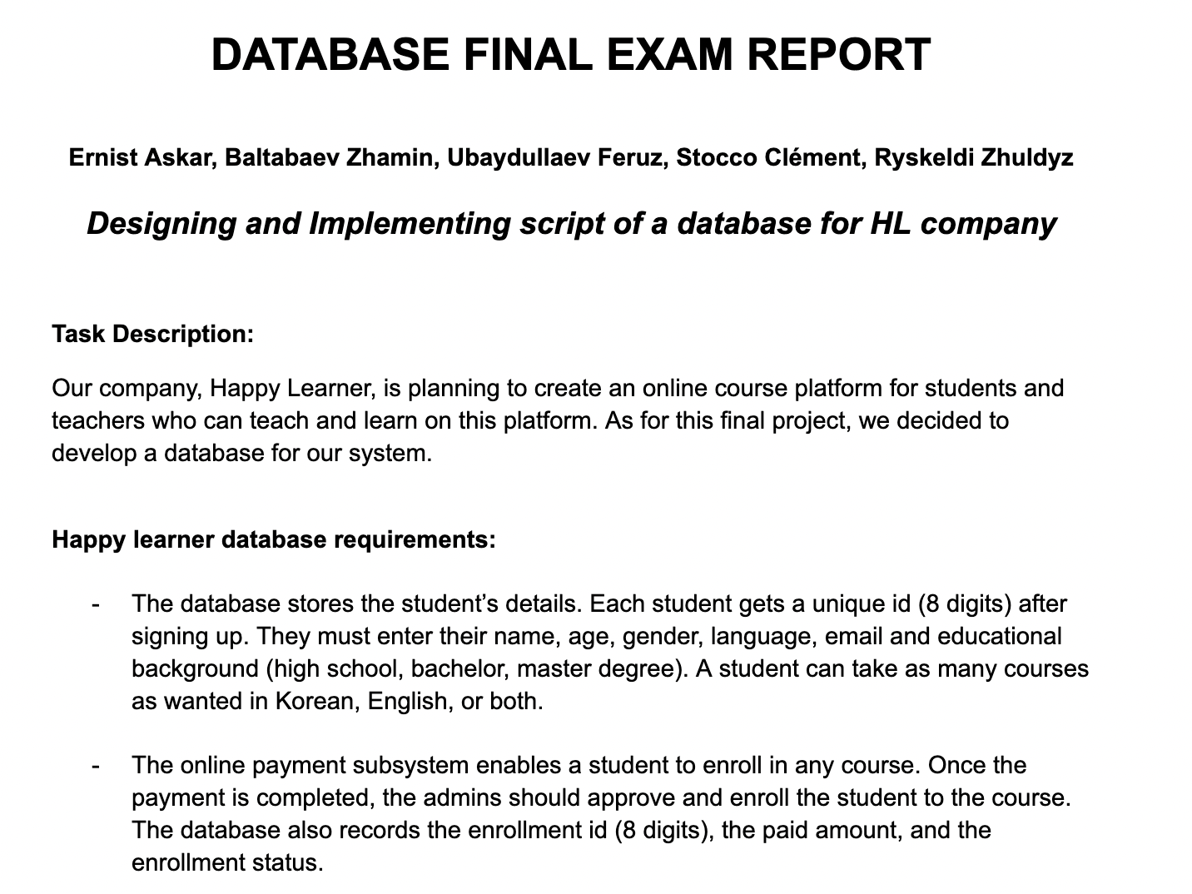

Slide 5
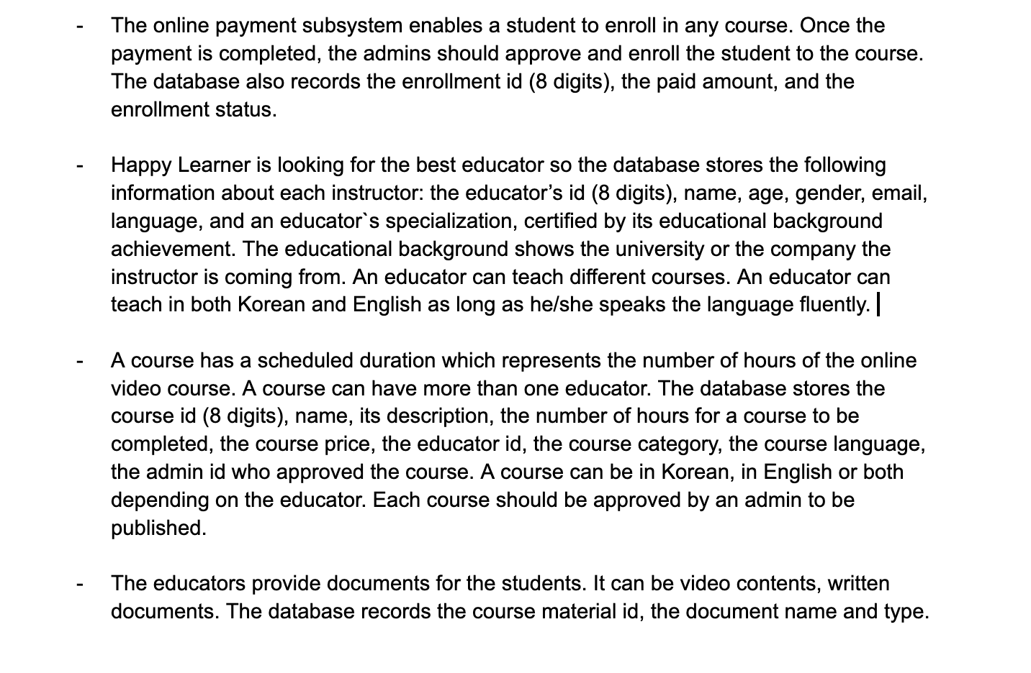

Slide 6
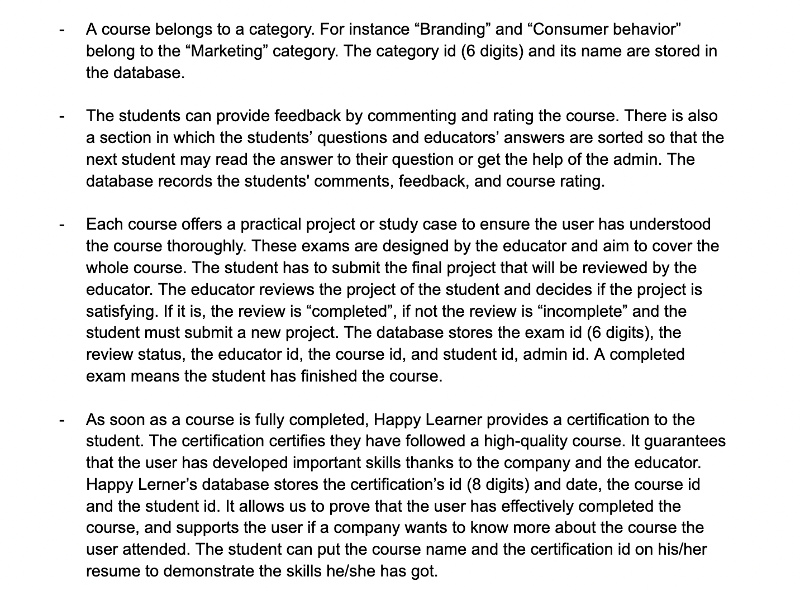

Slide 7
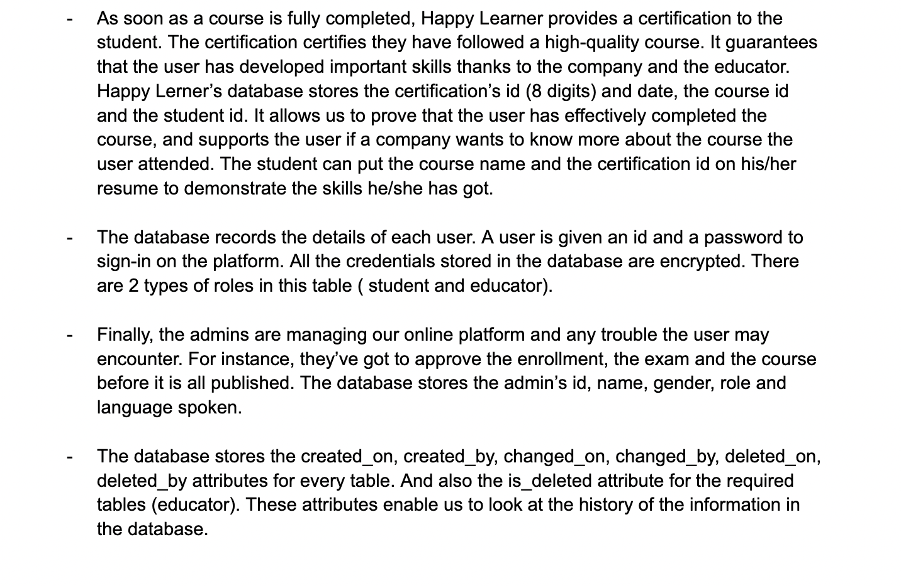

Slide 8

ERD MODEL

Slide 9
BRIEF INFORMATION
12 tables
one-to-one
one-to-many
many-to-many

Slide 10
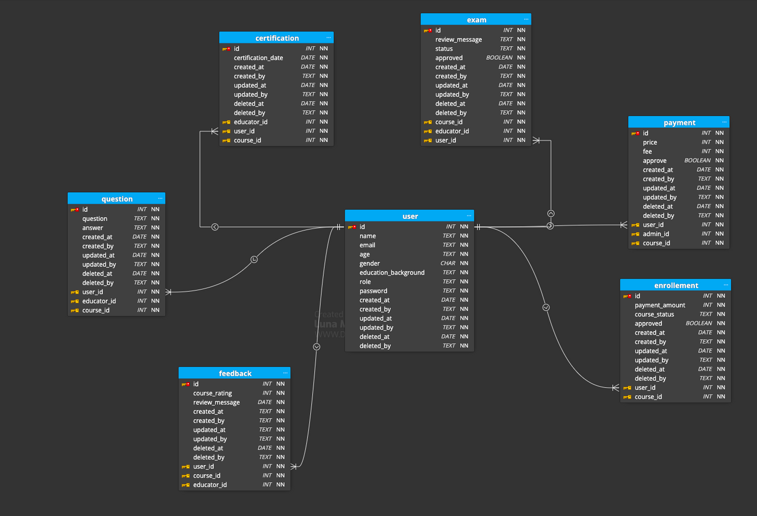
USER

Slide 11
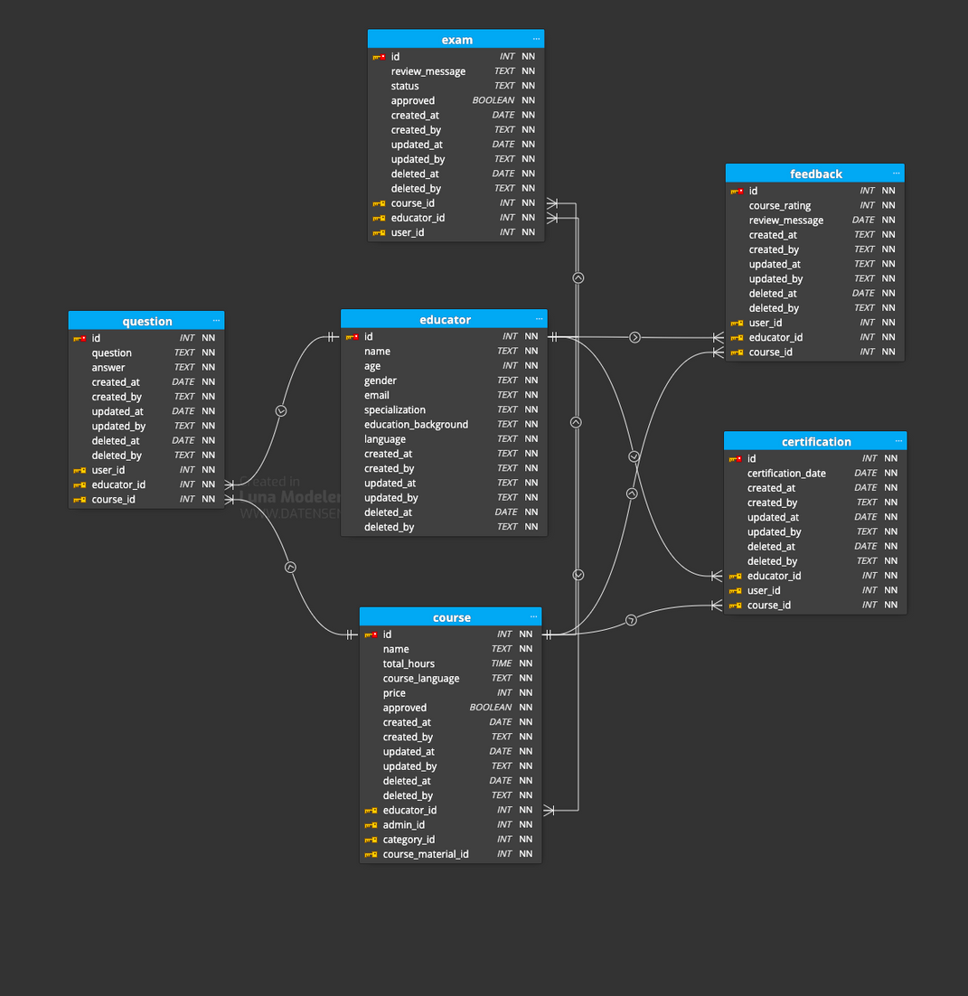
EDUCATOR

Slide 12
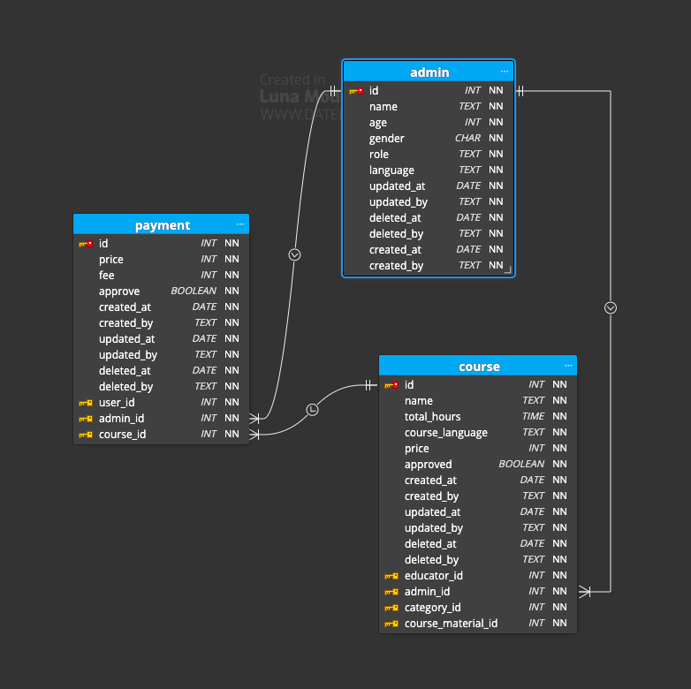
ADMIN

Slide 13
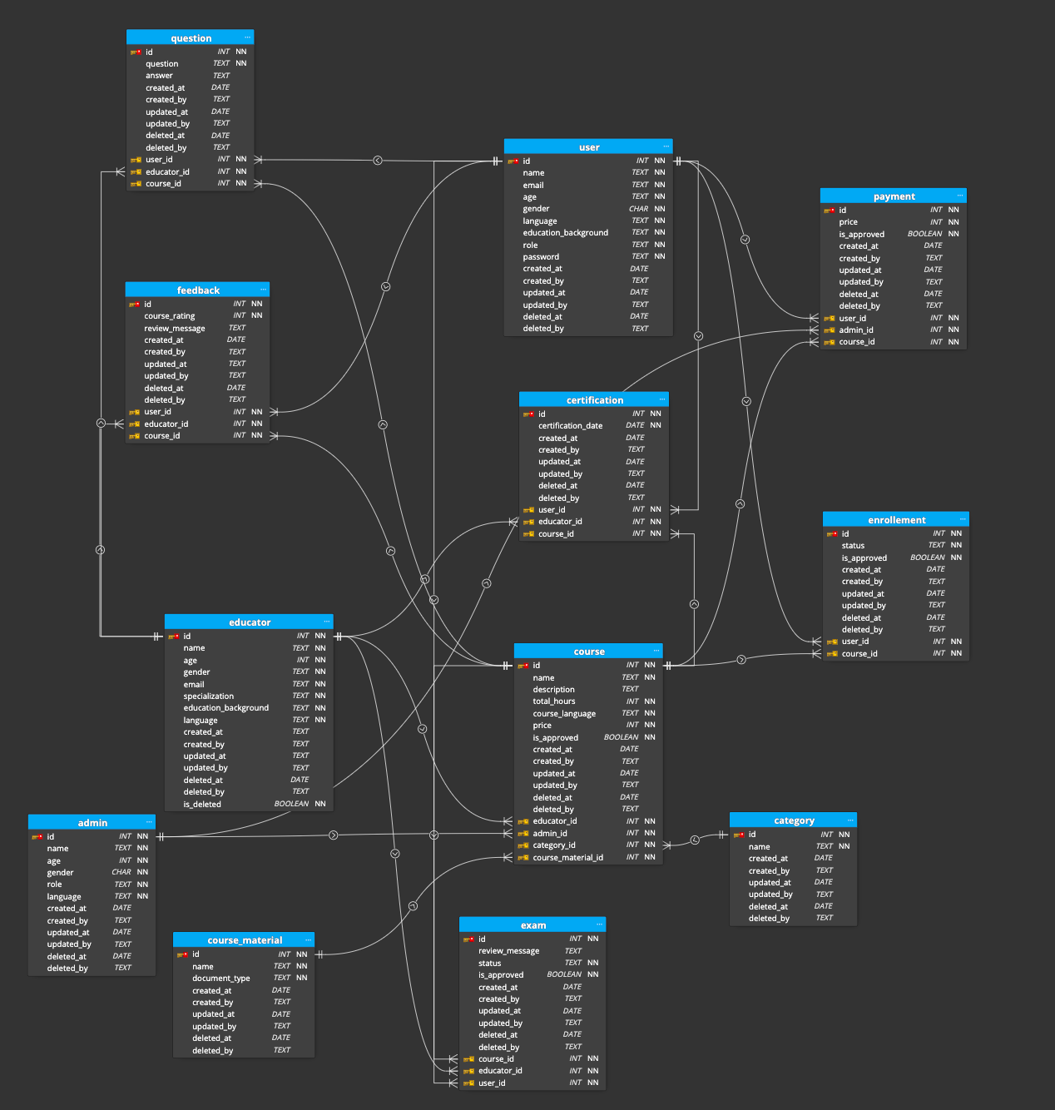
OVERALL

Slide 14

PROGRAMMING PART
GitHub
Click Here

Slide 15

THANK YOU FOR YOUR ATTENTION!

